Slide 1
CYB 110 CYBERSECURITY AND PRIVACY MODULE 5 - CRYPTOGRAPHY JIM ALVES-FOSS AND JIA SONG

Slide 2
INTRODUCTION TO CRYPTOGRAPHY
Module Description:
This module provides an overview of cryptography. Students will be given an overview at first, such as different encryption methods. Then more details will be provided on symmetric cryptography and asymmetric cryptography, such as DES, AES, RSA. Another micro module talks about cryptographic applications that are widely used in the real world.
Topics:
Cryptography Overview
Symmetric and Asymmetric Cryptography
Cryptographic Applications

Slide 3
CRYPTOGRAPHY OVERVIEW
Topics:
Basic concepts of cryptography (encryption, decryption, plaintext, ciphertext, key)
Different methods of encryption (substitution, transposition), diffusion, confusion, symmetric encryption, asymmetric encryption, block encryption, stream encryption.
Learning Outcomes:
Upon completion of this lesson:
Students will be able to list the elements of a cryptographic system.

Slide 4
WARM UP
Where do we need encryption?
Do you use encryption? How?

Slide 5
TERMINOLOGY (1)
Cryptography - The discipline that embodies the principles, means, and methods for the transformation of data in order to hide their semantic content, prevent their unauthorized use, or prevent their undetected modification.
Cryptographic system - Associated information assurance items interacting to provide a single means of encryption or decryption.
Plaintext - Data input to the Cipher or output from the Inverse Cipher.
Ciphertext - Data output from the Cipher or input to the Inverse Cipher.
Cipher - Any cryptographic system in which arbitrary symbols or groups of symbols, represent units of plain text, or in which units of plaintext are rearranged, or both.

Slide 6
TERMINOLOGY (2)
Encryption (encode, encipher) - Conversion of plaintext to ciphertext through the use of a cryptographic algorithm.
Decryption (decode, decipher) - Conversion of ciphertext to plaintext through the use of a cryptographic algorithm.
Cryptology - The science that deals with hidden, disguised, or encrypted communications. It includes communications security and communications intelligence.
Cryptanalysis – The study of mathematical techniques for attempting to improve or defeat cryptographic techniques and information-system security. This includes the process of looking for errors or weaknesses in the implementation of an algorithm or in the algorithm itself.

Slide 7
ENCRYPTION NOTATION

Slide 8
ENCRYPTION KEYS

Slide 9
CRYPTOGRAPHY CLASSIFICATION
By number/use of keys
Symmetric (Secret key cryptography)
Asymmetric (Public key cryptography)
By how plaintext is processed
Block encryption
Stream encryption
By encryption operations
Transposition
Substitution
Hybrid: Both substitution and transposition

Slide 10
BLOCK CIPHER
Block cipher - A cryptographic algorithm that transforms one block of information at a time using a cryptographic key (e.g., 8 characters/letters at a time).
For a block cipher algorithm, the length of the input block is the same as the length of the output block.
One block of elements will be processed at a time, an output block will be generated for each input block.

Slide 11
STREAM CIPHER
Stream cipher, each bit or each byte of the data stream is encrypted separately.
A stream cipher processes the input elements continuously, producing output one element at a time.

Slide 12
STREAM CIPHER VS. BLOCK CIPHER
 | Advantages | Disadvantages
Block cipher | High diffusion Insertions have low impact | Slower than stream cipher Padding needed High error propagation
Stream cipher | Fast Low error propagation | Low diffusion Susceptibility to insertions

Slide 13
TRANSPOSITION CIPHER
Transposition cipher: Rearrange letters in plaintext to produce ciphertext.
Example (Rail fence cipher):
Plaintext is HELLO WORLD
Rearrange as
HLOOL
ELWRD
Ciphertext is HLOOL ELWRD
Letters stay the same, but the order is all mixed up.

Slide 14
TRANSPOSITION CIPHER CONT.
Example:
Plaintext: “troops heading east need more supplies send more people now”
Ciphertext: “tidie rnmep ogose oerso paeep sssnl htude enpmn aepoo delrw”
t | r | o | o | p | s | h | e | a | d
i | n | g | e | a | s | t | n | e | e
d | m | o | r | e | s | u | p | p | l
i | e | s | s | e | n | d | m | o | r
e | p | e | o | p | l | e | n | o | w

Slide 15
ROW TRANSPOSITION CIPHER
Row Transposition Ciphers: Write letters in rows, reorder the columns according to the key before reading off.
Key: 4312567
Column Out: 4 3 1 2 5 6 7
a t t a c k p
o s t p o n e
d u n t i l t
w o a m x e e
Ciphertext: ttnaaptmtsuoaodwcoixknlepete

Slide 16
SUBSTITUTION CIPHER
Change characters in plaintext to produce ciphertext
First recorded use of Substitution Cipher is Ceasar cipher.
Plaintext is “HELLO WORLD”
Change each letter to the third letter following it (A to D, X to A, Y to B, Z to C)
Key is 3, usually written as letter ‘D’
Ciphertext is “KHOOR ZRUOG”

Slide 17
CEASER CIPHER
LETTER | A | B | C | D | E | F | G | H | I
CODE | 0 | 1 | 2 | 3 | 4 | 5 | 6 | 7 | 8
LETTER | J | K | L | M | N | O | P | Q | R
CODE | 9 | 10 | 11 | 12 | 13 | 14 | 15 | 16 | 17
LETTER | S | T | U | V | W | X | Y | Z
CODE | 18 | 19 | 20 | 21 | 22 | 23 | 24 | 25

Slide 18
EXERCISE 1 (DECIPHER THIS)
Ciphertext: (hint, key is NOT 3)
LEWLJAPUN ADV OVTLDVYR HZZPNUTLUAZ AOPZ DLLR
Hint: Character Frequency and letter patterns
LETTER | A | B | C | D | E | F | G | H | I
CODE | 0 | 1 | 2 | 3 | 4 | 5 | 6 | 7 | 8
LETTER | J | K | L | M | N | O | P | Q | R
CODE | 9 | 10 | 11 | 12 | 13 | 14 | 15 | 16 | 17
LETTER | S | T | U | V | W | X | Y | Z
CODE | 18 | 19 | 20 | 21 | 22 | 23 | 24 | 25

Slide 19
EXERCISE 1 ANSWER
Ciphertext:
LEWLJAPUN ADV OVTLDVYR HZZPNUTLUAZ AOPZ DLLR
Plaintext:
EXPECTING TWO HOMEWORK ASSIGNMENTS THIS WEEK
Key is 7

Slide 20
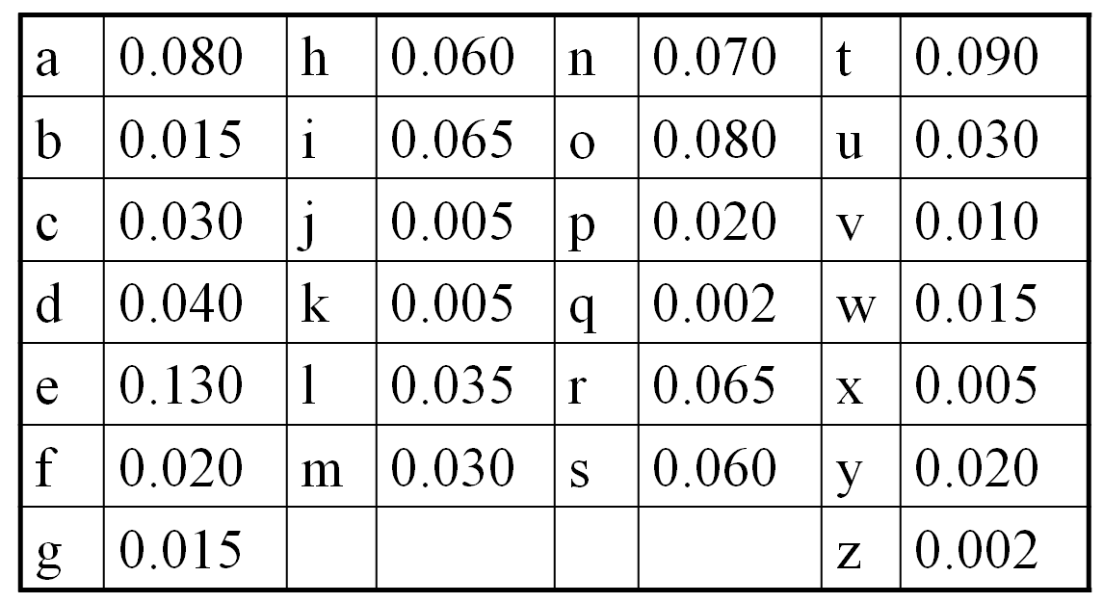
STATISTICAL ANALYSIS
Text in any natural language has patterns.
Character frequencies
Certain letter pairs: EN, RE, ER, and NT
Certain letter triples: ION, AND, and ING
TOP 9:
E 0.130
T 0.090
A 0.080
O 0.080
N 0.070
I 0.065
R 0.065
H 0.060
S 0.060

Slide 21
VIGÈNERE CIPHER
Like Ceasar cipher, but use a phrase for the key
Example
Plaintext: THE BOY HAS THE BALL
Key: VIG
Encipher using Ceasar cipher for each letter:
key VIG VIG VIG VIG VIG V
21 8 6 (REPEATED)
plain THE BOY HAS THE BAL L
cipher OPK WWE CIY OPK WIR G
T(19)+ V(21) mod 26 = O(14)
H(7) + I(8) mod 26 = P(15)
E(4) + G(6) mod 26 = K(10)
A | B | C | D | E | F | G | H | I
0 | 1 | 2 | 3 | 4 | 5 | 6 | 7 | 8
J | K | L | M | N | O | P | Q | R
9 | 10 | 11 | 12 | 13 | 14 | 15 | 16 | 17
S | T | U | V | W | X | Y | Z
18 | 19 | 20 | 21 | 22 | 23 | 24 | 25

Slide 22
EXERCISE 2
Decipher this Ciphertext:
I I P Q I F Y S T Q W W B T N U I U R E U F
Key is MEC
Hint:
2 - 5 mod 26
Is same as
(2-5)+26 mod 26 = 23
A | B | C | D | E | F | G | H | I
0 | 1 | 2 | 3 | 4 | 5 | 6 | 7 | 8
J | K | L | M | N | O | P | Q | R
9 | 10 | 11 | 12 | 13 | 14 | 15 | 16 | 17
S | T | U | V | W | X | Y | Z
18 | 19 | 20 | 21 | 22 | 23 | 24 | 25

Slide 23
EXERCISE 2 ANSWER
Ciphertext:
I I P Q I F Y S T Q W W B T N U I U R E U F
Key is MEC
W E N E E D M O R E S U P P L I E S F A S T
I (8) – M (12) mod 26 = W (22)
I (8) – E (4) mod 26 = E (4)
P (15) – C (2) mod 26 = N (13)
A | B | C | D | E | F | G | H | I
0 | 1 | 2 | 3 | 4 | 5 | 6 | 7 | 8
J | K | L | M | N | O | P | Q | R
9 | 10 | 11 | 12 | 13 | 14 | 15 | 16 | 17
S | T | U | V | W | X | Y | Z
18 | 19 | 20 | 21 | 22 | 23 | 24 | 25

Slide 24
CONFUSION VS DIFFUSION
Confusion: An encryption operation where the relationship between the key and ciphertext is obscured.
by doing substitution
each letter can be mapped to any other letters
Diffusion: An encryption operation where the influence of one plaintext bit is spread over many ciphertext bits.
hiding statistical properties of the plaintext
a letter is not just mapped to another letter in the English alphabet
by doing permutation

Slide 25
ASYMMETRIC ENCRYPTION (A PAIR OF KEYS)

Slide 26
ATTACKS ON ENCRYPTION
Brute-force attack
Try all possible keys
Smarter than brute force:
Frequency analysis, known plaintext, chosen plaintext, differential cryptanalysis, related key attack, birthday attack, downgrade attack, precomputation, implementation attacks, social-engineering attacks

Slide 27
COMMON ENCRYPTION
DES (Data Encryption Standard)
Cryptographic algorithm designed for the protection of unclassified data and published by the National Institute of Standards and Technology (NIST) in Federal Information Processing Standard (FIPS) Publication 46.
The DES performs series of bit permutations, substitutions, and recombination operations on blocks containing 64 bits of data and 56 bits of key (8-bit parity)
64-bit input, 64-bit output
64 bits of input are permuted at first, and then input to a function using static tables of permutations and substitutions

Slide 28
COMMON ENCRYPTION (2)

Slide 29
MEET IN THE MIDDLE ATTACK

Slide 30
MEET IN THE MIDDLE (2)
To break normal DES (with “known plaintext attack”)
Try 2⁵⁶ possible keys
To break double DES, first thought 2¹¹² possible keys
With meet-in-the middle: Preparation (2⁵⁶), then tries (2⁵⁶) for total of = 2⁵⁷

Slide 31
TRIPLE DES (3DES)

Slide 32
DES WEAK KEYS
DES uses 16 48-bit keys generated from a master 56- bit key (64 bits if we consider also parity bits)
Weak keys: keys make the same sub-key to be generated in more than one round.
Result: reduce cipher complexity
Weak keys can be avoided at key generation.
DES has 4 weak keys
01010101 01010101
FEFEFEFE FEFEFEFE
E0E0E0E0 F1F1F1F1
1F1F1F1F 0E0E0E0E

Slide 33
COMPARE DES ENCRYPTIONS
Encryption | Operation | Key length | Strength
DES | Encrypt with one key | 56-bit | 56-bit
Double DES | Encrypt with one key, then encrypt the result with another key | Two 56-bit keys | 57-bit
Two-key Triple DES | Encrypt with one key, then encrypt (or decrypt) the result with another key, then encrypt with the first key again | Two 56-bit keys | 80-bit
Three-key Triple DES | Encrypt with one key, then encrypt (or decrypt) the result with another key, then encrypt with the third key | Three 56-bit keys | 112-bit

Slide 34
ADVANCED ENCRYPTION STANDARD (AES)
Overview AES (Adopted in 2001)
Fast algorithm
Can be implemented on simple processor
Uses substitution and transposition plus shift, XOR and addition operations
Uses repeated cycles – called rounds in AES
There are 10, 12, or 14 cycles for keys of 128, 192, and 256 bits.
Each cycle consists of 4 steps
Steps perform both confusion and diffusion on input data
Bits from key are combined with intermediate results frequently, so key bits will be well diffused

Slide 35
(QUICK ASIDE) EXCLUSIVE OR ⊕
Common operation in cryptography.
1 xor 1 = 0
1 xor 0 = 1
0 xor 1 = 1
0 xor 0 = 0
10110011
⊕
10001111
=
00111100

Slide 36
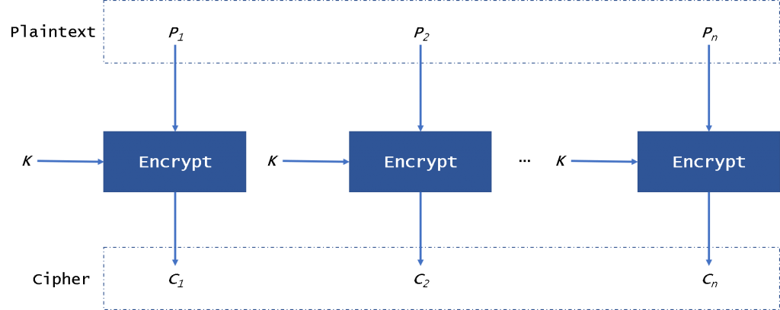
SYMMETRIC KEY CHALLENGES
First challenge is to prevent replay attacks and known plaintext attack.
Electronic codebook mode ECB:
How does this work with streams of data?
How can we provide more diffusion? Prevent replay of a block?

Slide 37
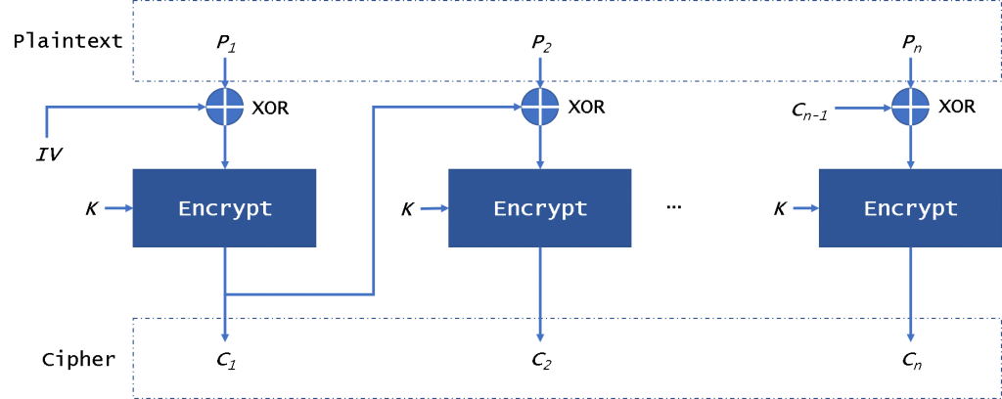
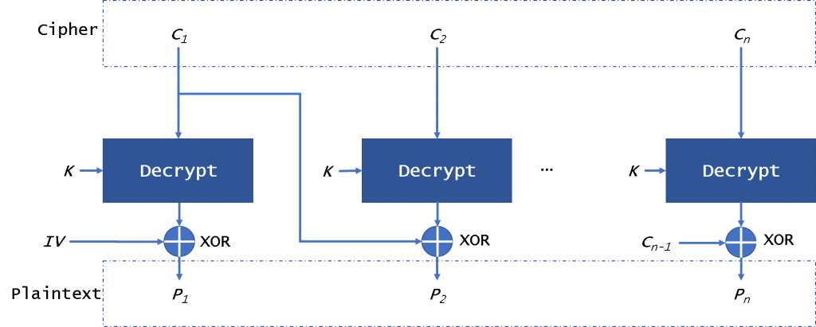
CIPHER BLOCK CHAINING MODE (CBC)

Slide 38
CIPHER FEEDBACK MODE (CFB)

Slide 39
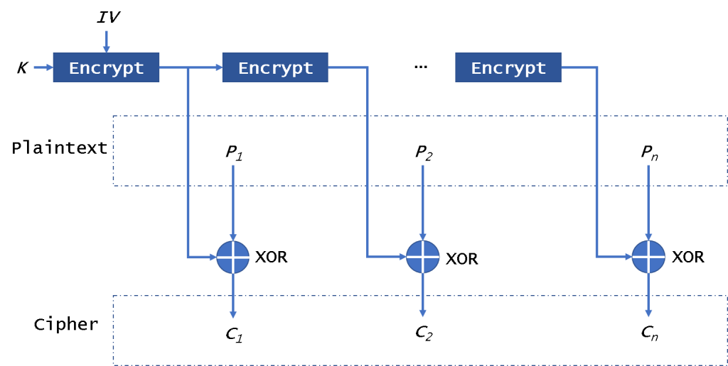
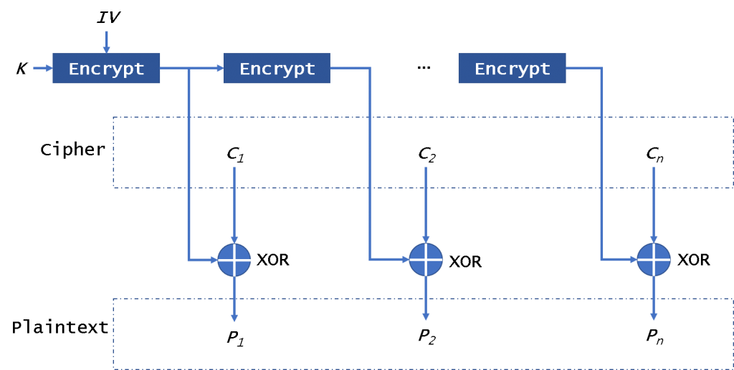
Output
Feedback
Mode
(OFB)

Slide 40
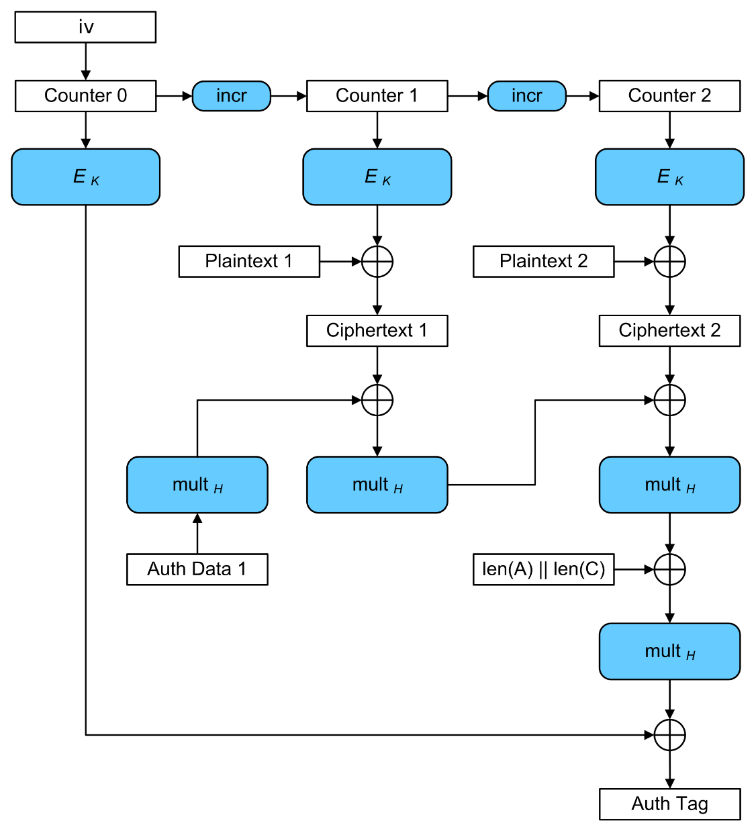
Galois Counter Mode

Slide 41
Mode | Advantage | Disadvantage
Electronic Codebook (ECB) | Simple Fast Support for parallel (encryption/decryption) | Duplicate data in plaintext is repeated in ciphertext Can change plaintext by changing cyphertext Can’t resist replay attacks Should not be used
Cipher Block Chaining (CBC) | Support for parallel decryption Can decrypt any ciphertext packet Duplicate data in plaintext is NOT repeated in ciphertext | Does not support parallel encryption Corrupted block will affect subsequent block
Cipher Feedback (CFB) | No padding needed Support for parallel decryption Can decrypt any ciphertext packet Can prepare keys for encryption/decryption | Does not support parallel encryption Can’t resist replay attacks Corrupted block will affect subsequent block
Output Feedback (OFB) | No padding needed Can prepare keys for encryption/decryption Corrupted blocks do not affect other blocks | Does not support parallel encryption or decryption Can change some ciphertext to corrupt plaintext, undetected
Counter (CTR) | No padding needed Support for parallel computation Can prepare keys for encryption/decryption Corrupted blocks do not affect other blocks | Can change some ciphertext to corrupt plaintext, undetected

Slide 42
SYMMETRIC KEY CHALLENGES (2)
Second challenge is getting sender and receiver to agree on the secret key without knowing by anyone else.
If the secret key is known by attackers, then they can later read, modify, and forge all messages encrypted or authenticated using that key
Key management: generation, transmission and storage of keys
All keys in secret-key cryptosystem must remain secret
Secret-key cryptography often has problems with secure key management
Especially in open systems with large number of users

Slide 43
PREVIOUS LECTURE
Symmetric/secret key encryption
Involve using one key for both encryption and decryption
Commonly used symmetric encryption algorithms
DES, Double DES, Triple DES, AES
Symmetric key encryption challenges
Replay attacks and known plain text attacks.
Key management (generation, transmission and storage of keys)
In order to solve the key management problem, Whitfield Diffie and Martin Hellman introduced the concept of public-key cryptography in 1976.

Slide 44
PUBLIC KEY (ASYMMETRIC) CRYPTOGRAPHY
Each user in a network has a pair of keys associated with him/her
Public key
Published under the users name in a public directory accessible for everyone to read
Private key
Known only to the user, must be kept secret
All communications involve only public keys, and no private key is ever transmitted or shared.
Pair of keys generated by running a key-generation algorithm.
Mathematics of Public Key Cryptography involves complicated mathematical manipulations of large numeric numbers.

Slide 45
PUBLIC KEY (ASYMMETRIC) CRYPTOGRAPHY
For confidentiality
For authenticity
Notes:
1. One person talks to others. Only two keys per user. (public key)
In secret key cryptography, one key is needed for each user, and must be kept secret.
2. public and private keys can be applied in either order.
one for protecting confidentiality, one for authenticity.

Slide 46
PUBLIC KEY CRYPTOGRAPHY
Public key algorithms can be used for:
Key distribution
Confidentiality
Authenticity
Data integrity (error detection)
Digital signatures

Slide 47
SECRET KEY VS. PUBLIC KEY ENCRYPTION
Notes:
Symmetric and asymmetric algorithms have complementary strengths and weaknesses and are therefore used both for different purposes and in concert with each other.

Slide 48
PUBLIC-KEY CRYPTOGRAPHY MISCONCEPTIONS
Public-key cryptography is more secure than symmetric encryption.
Explain: the security of any encryption scheme depends on
(1) the length of the key. (2) the computational work involved in breaking a cipher.
Public-key encryption is a general-purpose technique that has made symmetric encryption outdated.
Explain: public-key encryption is slow; it has huge computational overhead.
Key distribution is not important in public-key encryption, compared to the key distribution needed in symmetric encryption.
Explain: for public key distribution, some form of protocol is needed, often involving a central agent. The procedures involved are no simpler or any more efficient than those required for symmetric encryption.

Slide 49
OUTLINE
Public key cryptography to exchange secret keys
Diffie-Hellman key agreement
Public key cryptography to protect confidentiality
RSA algorithm (Rivest-Shamir-Adelman)

Slide 50
CHALLENGES – EXCHANGE SECRET KEY
Main challenge is getting sender and receiver to agree on secret key without anyone else finding out.
Anyone who intercepts key in transit can later read, modify, and forge all messages encrypted or authenticated using that key.
Key management -- Generation, transmission and storage of keys.
All keys in secret-key cryptosystem must remain secret.
Secret-key cryptography often has problems with secure key management, especially in open systems with large number of users.
In order to solve the key management problem, Whitfield Diffie and Martin Hellman introduced the concept of public-key cryptography in 1976.

Slide 51
DIFFIE-HELLMAN KEY EXCHANGE
First published public-key algorithm
By Diffie and Hellman in 1976 along with the exposition of public key concepts
Used in a number of commercial products
Practical method to exchange a secret key securely that can then be used for subsequent encryption of messages
Security relies on difficulty of computing discrete logarithms

Slide 52
DIFFIE-HELLMAN
Example:
Alice and Bob share “public” keys
They agree on two large numbers: n, g (publicly known numbers)
n should be a prime number (at least 512 bits)
1 < g < n and g is a primitive root of n
Notes:
512 bits - approximately 200 decimal digits

Slide 53
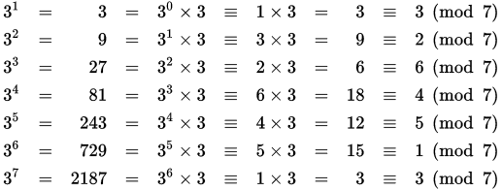
PRIMITIVE ROOT
A primitive root a of a prime number q is a number whose powers successively generate all the elements mod q (from 1 to q-1).
If a is a primitive root of the prime number q, then the numbers
a mod q, a ² mod q, …, a ^{q-1} mod q
are distinct and consist of the integers from 1 through q-1.
Example:
a = 3
q = 7

Slide 54
DIFFIE-HELLMAN
Example:
Alice and Bob share “public” numbers
They agree on two large numbers: n, g (publicly known numbers)
n should be a prime number (at least 512 bits)
1 < g < n and g is a primitive root of n

Slide 55
DIFFIE-HELLMAN
The Private Keys
Alice needs a private key
She chooses a large random integer, x
Bob needs a private key
He also chooses a large random integer, y

Slide 56
DIFFIE-HELLMAN
The Exchange, part 1
Alice uses her private key and the public numbers to compute X (cap X):
X = g ^{x} mod n
Alice sends X (cap X) to Bob
g, n public
x private
X sent to Bob
Bob uses his private key and the public numbers to compute Y (cap Y):
Y = g ^{y} mod n
Bob sends Y (cap Y) to Alice
g, n public
y private
Y sent to Alice

Slide 57
DIFFIE-HELLMAN
The Exchange, part 2
Alice computes k1 as follows
k1 = Y^{x} mod n
The keys
x is private
n is public
Y is from Bob
k1 is computed
Bob computes k2 as follows
k2 = X^{y} mod n
The keys
y is private
n is public
X is from Alice
k2 is computed

Slide 58
DIFFIE-HELLMAN
Keys K1 and K2 are identical!
k2 = X^{y} mod n
= (g^{x} mod n)^{y} mod n
= (g^{xy}) mod n
= (g^{yx}) mod n
= (g^{y} mod n)^{x} mod n
= (Y)^{x} mod n
= k1
Alice and Bob now have a shared secret key k (= k1 = k2)

Slide 59
DIFFIE-HELLMAN EXAMPLE
the g in our example

Slide 60
DIFFIE HELLMAN GROUPS
The 1024 bit MODP group , group 1 (from RFC 2409)
The prime is 2^1024 - 2^960 - 1 + 2^64 * { [2^894 pi] + 129093 }.
Its hexadecimal value is
FFFFFFFF FFFFFFFF C90FDAA2 2168C234 C4C6628B 80DC1CD1
29024E08 8A67CC74 020BBEA6 3B139B22 514A0879 8E3404DD
EF9519B3 CD3A431B 302B0A6D F25F1437 4FE1356D 6D51C245
E485B576 625E7EC6 F44C42E9 A637ED6B 0BFF5CB6 F406B7ED
EE386BFB 5A899FA5 AE9F2411 7C4B1FE6 49286651 ECE65381
FFFFFFFF FFFFFFFF
The generator is: 2.

Slide 61
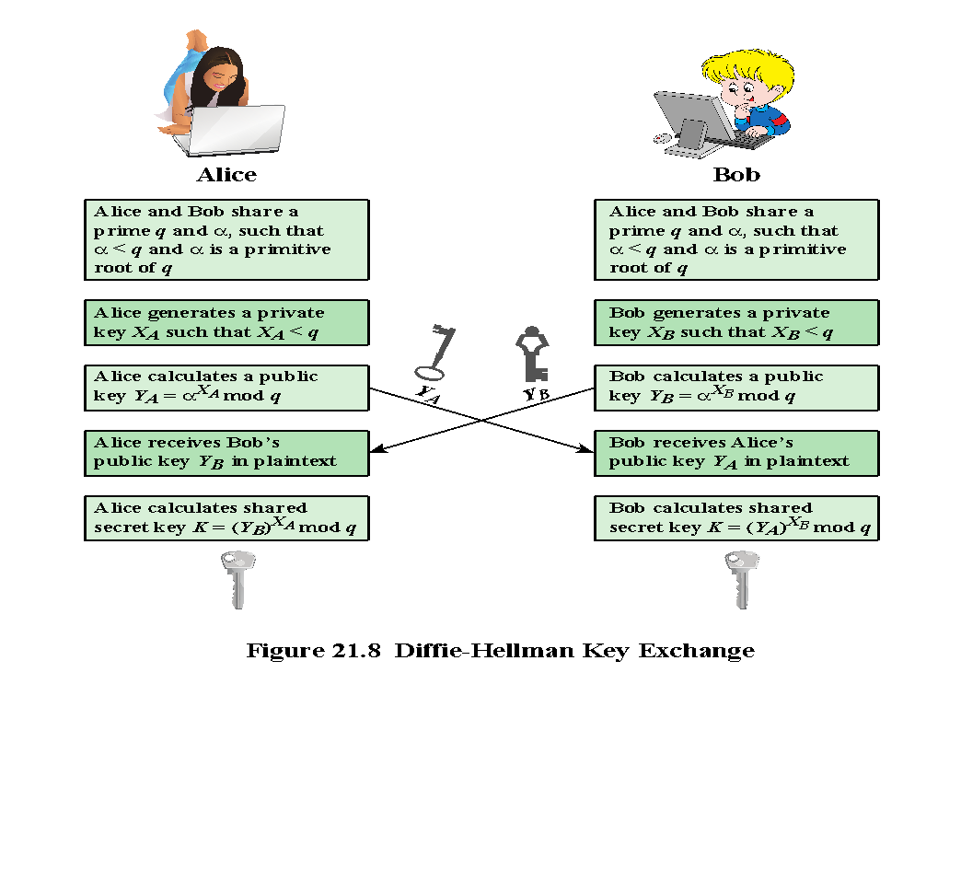
KEY EXCHANGE PROTOCOL
Simple protocol that makes use of the Diffie-Hellman calculation.

Slide 62
SECURITY OF DIFFIE-HELLMAN ALGORITHM
The protocol depends on discrete logarithm problem for its security.
It assumes that it is computationally infeasible to calculate the shared secret key.
Even if an attacker can obtain n, g, X, and Y, he cannot directly compute k = k1 = k2 (with large numbers, it is impractical)
Algorithm is relatively efficient in terms of yielding a good key for use in a symmetric algorithm.

Slide 63
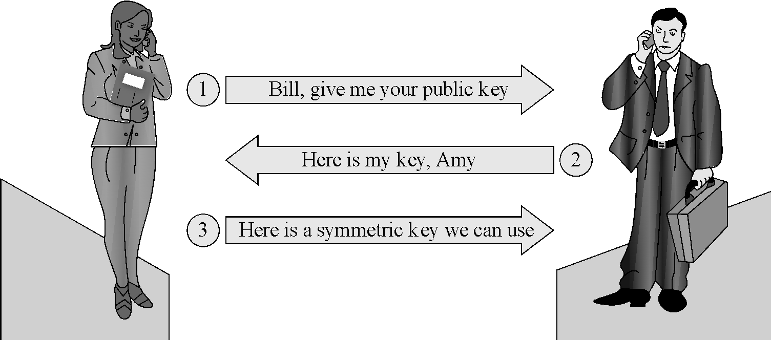
KEY EXCHANGE PROTOCOL: AN EXAMPLE
Amy and Bill want to establish a secret (symmetric algorithm) encryption key that only they know.
1. Amy says: Bill, please send me your public key.
2. Bill replies: Here, Amy; this is my public key
3. Amy responds: Thanks. I have generated a symmetric key for us to use for this interchange. I am sending you the symmetric key encrypted under your public key.

Slide 64
MAN-IN-THE-MIDDLE ATTACK
(1a) The attacker intercepts the message and fashions a new message to Bill, purporting to come from Amy but with the attacker’s return address, asking for Bill’s public key.
(2a) The attacker holds Bill’s public key and sends his own public key to Amy, alleging it is from Bill.
(3a) The attacker intercepts this message and obtains and holds the symmetric key Amy has generated. The attacker then generates a new symmetric key, encrypts it with Bill’s public key and sends it to Bill.

Slide 65
MAN-IN-THE-MIDDLE ATTACK
At this point, Bob and Alice think that they share a secret key, but instead Bob and Darth share secret key K1, and Alice and Darth share secret key K2. All future communication between Bob and Alice is compromised in the following way:
Alice sends an encrypted message M: E(K2, M).
Darth intercepts the encrypted message and decrypts it, to recover M.
Darth sends Bob E(K1, M) or E(K1, M'), where M' is any message. In the first case, Darth simply wants to eavesdrop on the communication without altering it. In the second case, Darth wants to modify the message going to Bob.

Slide 66
MAN-IN-THE-MIDDLE ATTACK
The key exchange protocol is vulnerable to such an attack because it does not authenticate the participants.
The vulnerability can be overcome with the use of digital signatures and public-key certificates. (Later lectures)

Slide 67
OUTLINE
Public key cryptography to exchange secret keys
Diffie-Hellman key agreement
Public key cryptography to protect confidentiality
RSA algorithm (Rivest-Shamir-Adelman)

Slide 68
RSA
The RSA Public Key Cryptography was invented by Ronald Rivest, Adi Shamir, and Leonard Adelman in 1978.
Encrypted messages can be passed from the sender to the receiver, and decrypted by the receiver, without having to pass a secret decryption key between them.
A public/private key pair is used. The public key, which can be safely published for all to know, is used to encrypt the message.
The private key, which is held by the owner, and which is never shown to anybody, is used to decrypt the message.

Slide 69
ASYMMETRIC ENCRYPTION WITH RSA
Since its introduction in 1978, RSA has been the subject of extensive cryptanalysis, and no serious flaws have yet been found
The encryption algorithm is based on the underlying problem of factoring large prime numbers
Two keys, d and e, are used for decryption and encryption (they are interchangeable)
The plaintext block P is encrypted as P^{e} mod n
The decrypting key d is chosen so that (P^{e})^{d} mod n = P

Slide 70
DERIVING A KEY PAIR
The encryption key consists of the pair of integers (e, n), and the decryption key is (d,n).
To find keys:
Select the value of n. (n should be quite large (512bits, 768bits, 1024bits or more), a product of two primes p and q.)
Choose an integer e < n relatively prime to (p-1)*(q-1).
Find second integer d, such that
ed mod φ(n) = 1
The user distributes e and n and keeps d secret: p, q, φ(n) can be discarded.
Even though n is known to be the product of two primes, if they are relatively large, it will not be feasible to determine the primes p and q, or the private key d from e. Therefore, this scheme provides adequate security for d.
Notes:
Typically, p and q are nearly 100 digits each, so n is approximately 200 decimal digits (about 512 bits) long
A large value of n effectively inhibits factoring n to infer p and q (but time to encrypt increases as the value of n grows larger)
In number theory, two integers a and b are said to be relatively prime or coprime if the only positive integer that divides both of them is 1. This is equivalent to their greatest common divisor being 1.

Slide 71
RSA ALGORITHM EXAMPLE
1) Generate a public Key and a Private key
Choose, two large prime numbers, p and q
for example: p = 7, q = 19
2) Let n = pq
n = 7 * 19 = 133
3) Let φ(n) = φ(p) φ(q) = (p - 1)(q - 1)
φ(n) = (7 - 1)(19 - 1) = 6 * 18 = 108
Notes:
Euler's totient function is a multiplicative function

Slide 72
RSA ALGORITHM EXAMPLE (CONT.)
4) Choose a number, e coprime to φ(n)
e = 2 => gcd(e, 108) = 2 (no) e = 3 => gcd(e, 108) = 3 (no) e = 4 => gcd(e, 108) = 4 (no) e = 5 => gcd(e, 108) = 1 (yes!)
5) Find d, such that d*e mod φ(n) = 1
We can rewrite this as d = (1 + k *φ(n) ) / e. Now we work through values of k until an integer solution for d is found:
d = ( 1 + k*108 ) / 5
k = 0 => d = 1 / 5 (no) k = 1 => d = 109 / 5 (no) k = 2 => d = 217 / 5 (no) k = 3 => d = 325 / 5 = 65 (yes!)
Notes:
greatest common divisor being 1

Slide 73
RSA
Encryption algorithm
Public key is (e,n) private key is (d,n)
c = p^{e} mod n and p = c^{d} mod n
encryption decryption
Because of symmetry in modular arithmetic, encryption and decryption are mutual inverses and commutative.
P = c^{d} mod n = (p^{e} ) ^{d}mod n = (p^{d} ) ^{e}mod n
The relationship means that one can apply the encrypting transformation and then the decrypting one, or the decrypting one followed by the encrypting one.

Slide 74
RSA ALGORITHM
Encryption Example
For this example, lets use the message "6".
C = P^{e} mod n = 6⁵ mod 133
Public Key
n = 133 e = 5
Secret Key
n = 133 d = 65
= 7776 mod 133 = 62

Slide 75
RSA DECRYPTION EXAMPLE
Power rule: (b^{n})^{m} = b^{n⋅m}
Public Key
n = 133 e = 5
Secret Key
n = 133 d = 65

Slide 76
RSA DECRYPTION EXAMPLE (CONT.)
Power rule: (b^{n})^{m} = b^{n⋅m}
Public Key
n = 133 e = 5
Secret Key
n = 133 d = 65

Slide 77
SECURITY OF PUBLIC KEY ENCRYPTION
RSA key length is configurable
Asymmetric algorithms require longer keys to provide same level of security as symmetric keys
512 bit RSA public key is equivalent to a 64 bit symmetric key
768 bit RSA public key is equivalent to an 89 bit symmetric key
RSA encryption for protecting very high value transactions - at least a 1024 bit or higher key SHOULD be used.

Slide 78
SECRET KEY VS. PUBLIC KEY ENCRYPTION
Notes:
Symmetric and asymmetric algorithms have complementary strengths and weaknesses and are therefore used both for different purposes and in concert with each other.

Slide 79
SUMMARY
Asymmetric (public key) encryption
Involve using a pair of keys for encryption and decryption separately.
Public key cryptography to exchange secret keys
Diffie-Hellman key agreement
Public key cryptography to protect confidentiality
RSA algorithm (Rivest-Shamir-Adelman)

Slide 80
ERROR DETECTING CODES
Encryption protects against passive attack (eavesdropping). A different requirement is to protect against active attack (falsification of data).
Challenge: with important data, we need some way to determine that the data is complete and intact.
Error detecting codes come under many names:
such as: hash codes, message digests, checksums, integrity checks, error detection and correction codes, and redundancy test.
The basic purpose of all is to demonstrate that a block of data has been modified.
Some of the error detecting codes will signal that content has changed, but it is less solid at demonstrating no modification.

Slide 81
ERROR DETECTING CODES
Demonstrates that a block of data has been modified
Simple error detecting codes:
Hash code
Cryptographic error detecting codes:
One-way hash functions
Cryptographic checksums
Digital signatures

Slide 82
EXAMPLE: CHECKSUM ON A LETTER
Sam writes a letter, wants to send it to Amy.
He carefully counts the letters in the document, adds those values and writes the sum in tiny digits at the bottom of the letter.
using 1 for an a, 2 for a b, and so on up to 26 for a z.
eg. “meet you at five” 🡪 13+5+5+20+25+15+21+1+20+6+9+22+5 =167
Sam sends the letter to Amy
When Amy receives it, she does the same computation and compares her result to the one written at the bottom.
(1) the counts do not match
(2) there is no count
(3) the counts match

Slide 83
EXAMPLE: CHECKSUM ON A LETTER (CONT.)
Even if the counts match, it doesn’t mean the letter has not been altered.
“meet you at five” 🡪 13+5+5+20+25+15+21+1+20+6+9+22+5 =167
“meet you at nine” 🡪 13+5+5+20+25+15+21+1+20+14+9+14+5 = 167
For this type of simple hash code, the person who intercepted the letter is able to modify the content and generate the same hash code.
The problem arises because the code is a many-to-one function.
Two inputs that produce the same output are called a collision.

Slide 84
ERROR DETECTING CODES
Demonstrates that a block of data has been modified
Simple error detecting codes:
Hash code
Cryptographic error detecting codes:
One-way hash functions
Cryptographic checksums
Digital signatures

Slide 85
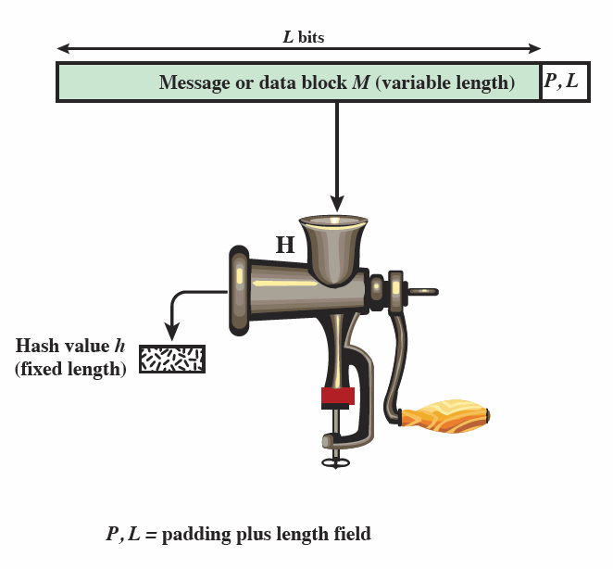
HASH FUNCTION
A hash function accepts a variable-size message M as input and produces a fixed-size message digest H(M) as output
Typically, the message is padded out to an integer multiple of some fixed length (e.g., 1024 bits) and the padding includes the value of the length of the original message in bits.
The length field is a security measure to increase the difficulty for an attacker to produce an alternative message with the same hash value.
Notes:
A hash function does not take a secret key as input.

Slide 86
SECURE HASH FUNCTION REQUIREMENTS
The purpose of a hash function is to produce a “fingerprint” of a file, message, or other block of data.
H can be applied to a block of data of any size.
H produces a fixed-length output.
H(x) is relatively easy to compute for any given x, making both hardware and software implementations practical.
For any given code h, it is computationally infeasible to find x such that H(x) = h. A hash function with this property is referred to as one-way hash function.
For any given block x, it is computationally infeasible to find y ≠ x with H(y) = H(x). A hash function with this property is referred to as weak collision resistant.
It is computationally infeasible to find any pair (x, y) such that H(x) = H(y). A hash function with this property is referred to as strong collision resistant.
Notes:
4. it is easy to generate a code given a message, but virtually impossible to generate a message given a code.
5. it is impossible to find an alternative message with the same hash value as a given message.

Slide 88
MODERN HASH FUNCTIONS
Modern hash functions meet two criteria:
They are one-way, meaning they convert input to a digest, but it is infeasible to start with a digest value and infer the input.
They do not have obvious collisions, meaning that it is infeasible to find a pair of inputs that produce the same digest.
Famous cryptography hash functions:
MD4, MD5
SHA-1, SHA-2, SHA-3

Slide 89
MD4 AND MD5
MD4 (Message Digest Algorithm) is a cryptographic hash function developed by Ronald Rivest in 1990.
The digest length is 128-bit.
The security of MD4 has been severely compromised.
MD5 (Message Digest Algorithm) was designed by Ronald Rivest in 1991 to replace MD4 (improved version of MD5).
However, collisions can be found in seconds using a home computer.
As of today, MD5 is still being used.
Notes:
Both condense a message of any size to a 128-bit digest

Slide 90
SECURE HASH ALGORITHM (SHA)
SHA was originally developed by NIST
Published as FIPS (Federal information processing standard) 180 in 1993
Was revised in 1995 as SHA-1
Produces 160-bit hash values
NIST issued revised FIPS 180-2 in 2002
Adds 3 additional versions of SHA
SHA-256, SHA-384, SHA-512 (collectively known as SHA-2)
Same basic structure as SHA-1 but greater security
In 2012, NIST standardized a new hash function (different from SHA-1 and SHA-2), SHA-3, which is now available as an alternative to SHA-2.
Notes:
weaknesses were discovered in SHA, a revised version SHA-1

Slide 91
CURRENT SECURE HASH STANDARD PROPERTIES

Slide 92
HASH FUNCTIONS
A hash function is a “compression” of the value in a message.
MD5 (1992) – output 128 bits (512 bit block size)
SHA1 (1992) – output is 160 bits (similar to MD5)
SHA2 (2001) – two most popular variants SHA-256 (512 bit block size) and SHA-512 (1024 bit block size)
SHA3 (2015) – SHA3-224, SHA3-256, SHA3-384, SHA3-512
NOT SECURE

Slide 93
ERROR DETECTING CODES
Demonstrates that a block of data has been modified
Simple error detecting codes:
Hash code
Parity checks
Cryptographic error detecting codes:
One-way hash functions
Digital signatures

Slide 94
MESSAGE AUTHENTICATION
Message authentication is a procedure that allows communicating parties to verify that received or stored messages are authentic.
The two important aspects are:
to verify that the contents of the message have not been altered
the source is authentic.

Slide 95
DIGITAL SIGNATURES
If we encrypt our message with our private key.
Anyone can decrypt and see the original message.
Supposedly I am the only person in the world who knows my private key and therefore the only one who could have encrypted the message this way. (be careful of these assumptions).
Since everyone can read it anyway, can we just encrypt the HASH?
Faster, since hash is much smaller.
Only bad if someone can create a new message with same hash.
If someone does not want to check the signature, can still read the message.

Slide 96
OUTLINE
Digital Signature
Public-Key Certificates

Slide 97
PUBLIC KEY (ASYMMETRIC) CRYPTOGRAPHY
For confidentiality
For authenticity
Notes:
1. One person talks to others. Only two keys per user. (public key)
In secret key cryptography, one key is needed for each user, and must be kept secret.
2. public and private keys can be applied in either order.
one for protecting confidentiality, one for authenticity.

Slide 98
Public Key Cryptography Providing Confidentiality

Slide 99
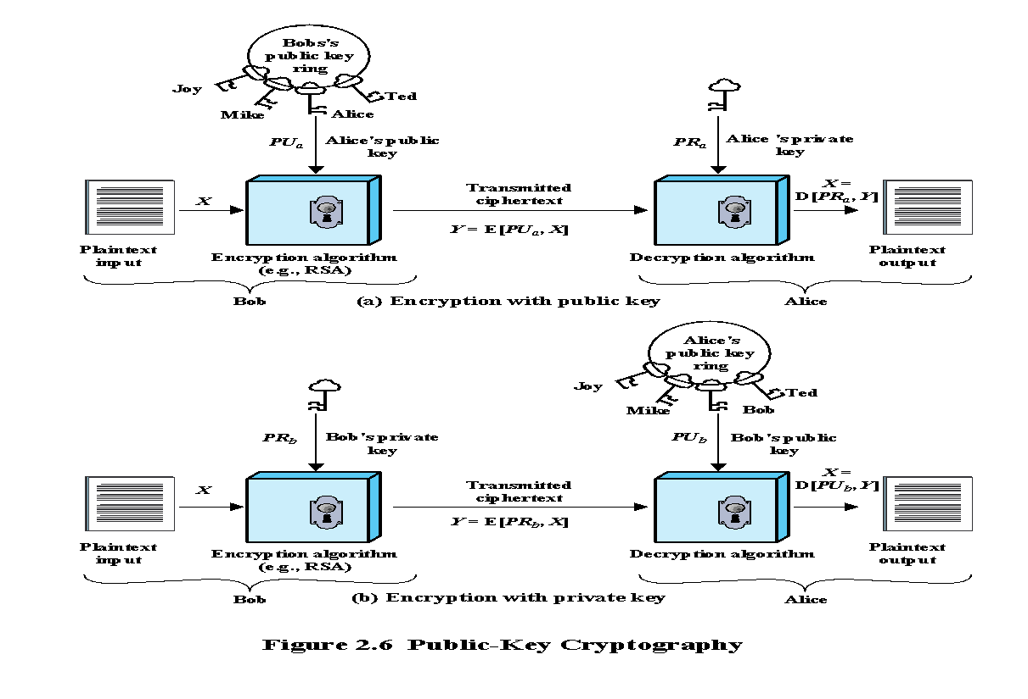
Public Key Cryptography Providing Authentication
Notes:
providing authentication
If a user is able to successfully recover the plaintext from Bob’s ciphertext using Bob’s public key, this indicates that only Bob could have encrypted the plaintext, thus providing authentication.
Digital signature is very similar

Slide 100
DIGITAL SIGNATURES
Digital signature - An asymmetric key operation where the private key is used to digitally sign data and the public key is used to verify the signature. Digital signatures provide authenticity protection, integrity protection, and non-repudiation [NIST].
Used for authenticating both source and data integrity
Created by encrypting hash code with private key
Does not provide confidentiality.
The message is sending in plaintext.
Notes:
Digital signature: encrypts the hash value, not the message with private key.
The message being sent is safe from alteration but not safe from eavesdropping. This is obvious in the case of a signature based on a portion of the message, because the rest of the message is transmitted in the clear. Even in the case of complete encryption, there is no protection of confidentiality because any observer can decrypt the message by using the sender’s public key.

Slide 101
DIGITAL SIGNATURES
Suppose that Bob wants to send a message to Alice. Although it is not important that the message be kept secret, he wants Alice to be certain that the message is indeed from him. For this purpose,
1. Bob uses a secure hash function to generate a hash value for the message.
2. Then he encrypts the hash code with his private key, creating a digital signature.
3. Bob sends the message with the signature attached.
Notes:
send message with the signature attached

Slide 102
DIGITAL SIGNATURES
When Alice receives the message plus signature, she
(1) calculates a hash value for the message;
(2) decrypts the signature using Bob’s public key;
(3) compares the calculated hash value to the decrypted hash value.
If the two hash values match, Alice is assured that the message must have been signed by Bob. No one else has Bob’s private key and therefore no one else could have created a ciphertext that could be decrypted with Bob’s public key.
In addition, it is impossible to alter the message without access to Bob’s private key, so the message is authenticated both in terms of source and in terms of data integrity.

Slide 103
DIGITAL SIGNATURES REQUIREMENTS
Digital signatures must meet two requirements and, ideally, satisfy two more:
Unforgeable (mandatory): No one other than the signer can produce the signature without the signer’s private key
Authentic (mandatory): The receiver can determine that the signature really came from the signer
Not alterable (desirable): No signer, receiver, or any interceptor can modify the signature without the tampering being evident
Not reusable (desirable): Any attempt to reuse a previous signature will be detected by receiver

Slide 104
DIGITAL SIGNATURES
The general way of computing digital signatures is with public key encryption:
The signer computes a signature value by using a private key
Others can use the public key to verify that the signature came from the corresponding private key
Problem:
Any user can send his/her public key to any other users or broadcast the key to the community.
Anybody can forge such a public announcement.
There is no reliable way to associate a user with that public key.
Solution: Public-Key Certificate
Notes:
Some user could pretend to be Bob and send a public key to another participant or broadcast such a public key.
The solution to this problem is the public-key certificate.

Slide 105
OUTLINE
Digital Signature
Public-Key Certificate

Slide 106
PUBLIC KEY ENCRYPTION ISSUES
The concern of public-key encryption is that the public key is public. An attacker could pretend to be someone and send a public key to another participant or broadcast the public key.
How to make sure the public key is authentic? The solution to this problem is the public-key certificate.
A user can present his or her public key to the authority in a secure manner and obtain a signed certificate. The user can then make certificate publicly available.
Anyone needing this user’s public key can obtain the certificate and verify that the attached signature.

Slide 107
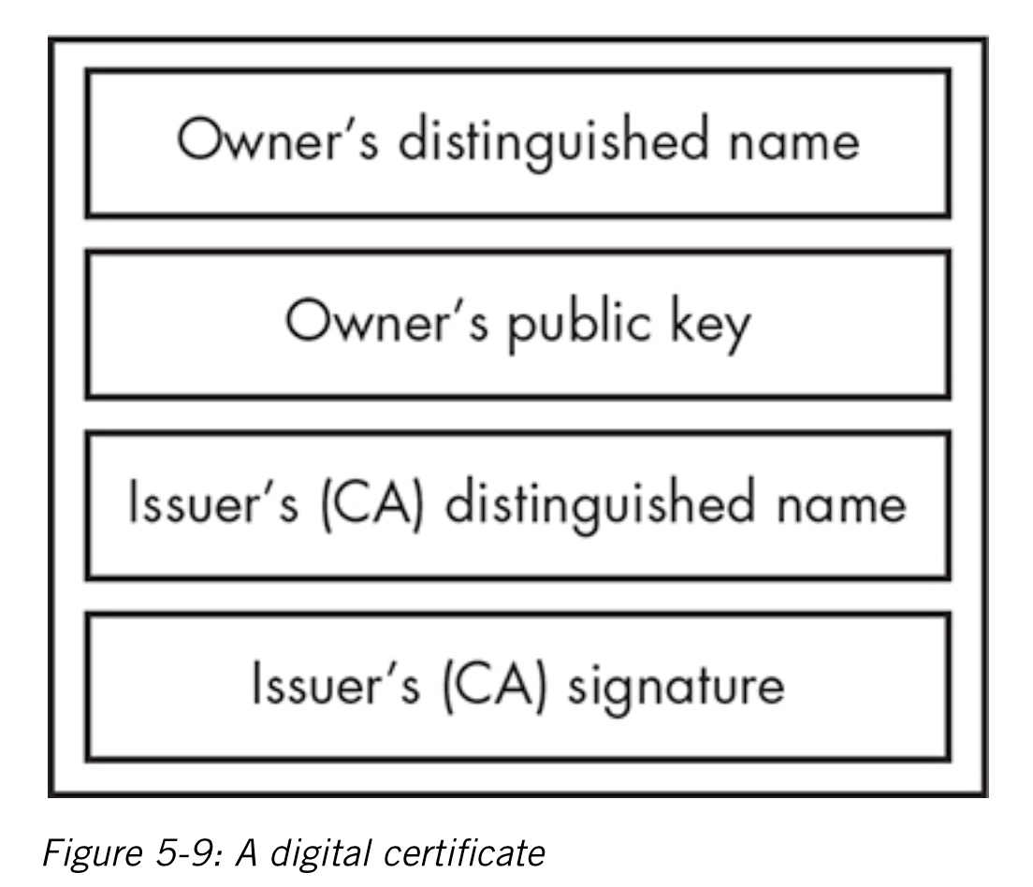
PUBLIC-KEY CERTIFICATES
What is a certificate?
A certificate is a public key and an identity bound together and signed by a certificate authority.
A certificate allows you to verify that a public key is truly associated with an individual.
Who’s managing the certificates?
Certificate Authority (CA) – A trusted entity that issues and revokes public key certificates, such as a government agency or a financial institution [NIST].

Slide 108
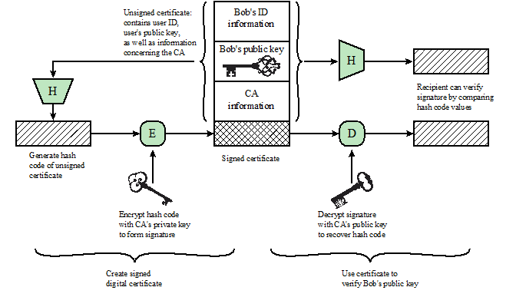
PUBLIC-KEY CERTIFICATES
Notes:
To get a public key certificates, these are the steps.

Slide 109
PUBLIC-KEY CERTIFICATES
Step 1: User creates a pair of keys: one public and one private

Slide 110
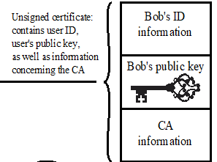
PUBLIC-KEY CERTIFICATES
Step 2: User prepares an unsigned certificate that includes the user ID, user’s public key, and information concerning the CA.
Step 3: User provides the unsigned certificate to a CA in some secure manner.

Slide 111
PUBLIC-KEY CERTIFICATES
Step 4: CA creates a signature as follows:
CA uses a hash function to calculate the hash code of the unsigned certificate.
CA generates digital signature using the CA’s private key and a signature generation algorithm.

Slide 112
PUBLIC-KEY CERTIFICATES
Step 5: CA attaches the signature to the unsigned certificate to create a signed certificate.
Step 6: CA returns the signed certificate to client.

Slide 113
PUBLIC-KEY CERTIFICATES
Step 7: User may provide the signed certificate to any other user.

Slide 114
PUBLIC-KEY CERTIFICATES
Step 8: Any user may verify that the certificate is valid as follows:
User calculates the hash code of certificate (not including signature).
User decrypts the signature using CA’s known public key
User compares the results of (a) and (b). If there is a match, the certificate is valid.

Slide 115
PUBLIC-KEY CERTIFICATES
X.509 standard is widely used for formatting public-key certificates.

Slide 116
CERTIFICATE CONTENTS
A digital representation of information which at least:
1) identifies the certificate authority issuing it,
2) user names or identity,
3) user’s public key,
4) operational period,
5) is digitally signed by the certificate authority issuing it.

Slide 117
PUBLIC KEY INFRASTRUCTURE
A public key infrastructure (PKI) usually has two main components:
the certificate authorities that issue and verify certificates,
the registration authorities that verify the identity of the individual associated with the certificate.
A PKI may also revoke certificates
reach their expiration date, are compromised, or other reasons.
added to a certificate revocation list (publicly available)

Slide 118
PUBLIC KEY CRYPTOGRAPHY SUMMARY
Public key algorithms can be used for:
Key distribution (Diffie-Hellman Key Exchange)
Protect Confidentiality (Encryption with public key, eg. RSA)
Authentication (Encryption with private key)
Data integrity (error detection)
Digital signatures
Digital certificates

Slide 119
CRYPTOGRAPHIC TOOL SUMMARY

Slide 120
PLEASE ATTRIBUTE DR. JIM ALVES-FOSS AND DR. JIA SONG, UNIVERSITY OF IDAHO EXCEPT WHERE OTHERWISE NOTED, THIS WORK IS LICENSED UNDER HTTPS://CREATIVECOMMONS.ORG/LICENSES/BY-NC-SA/4.0/ NOT WITHSTANDING THE NON-COMMERCIAL LICENSE TERMS, NON-PROFIT EDUCATIONAL INSTITUTIONS ARE GRANTED A NON-EXCLUSIVE LICENSE TO ADAPT AND USE THIS MATERIAL, WITH ATTRIBUTION. CREATIVE COMMONS AND THE DOUBLE C IN A CIRCLE ARE REGISTERED TRADEMARKS OF CREATIVE COMMONS IN THE UNITED STATES AND OTHER COUNTRIES. THIRD PARTY MARKS AND BRANDS ARE THE PROPERTY OF THEIR RESPECTIVE HOLDERS.

